Slide 1
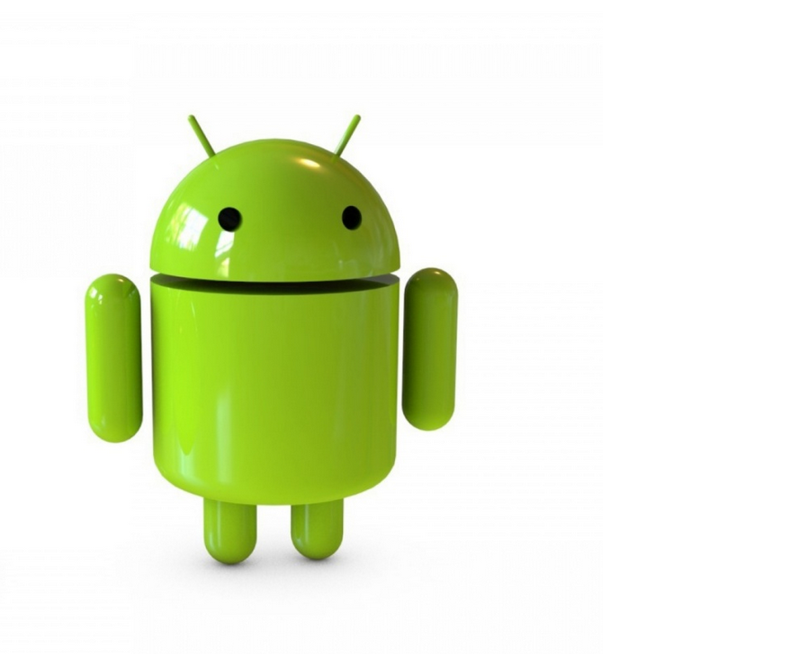
Android Application basics
Module II – Android Application Basics

Slide 2
Information architecture

Slide 3
Information Architecture
Information architecture (IA) focuses on organizing, structuring, and labeling content in an effective and sustainable way.
The goal is to help users find information and complete tasks.
To do this, you need to understand how the pieces fit together to create the larger picture, how items relate to each other within the system.

Slide 4
Mobile Information Architecture
In the mobile context it is especially important to structure information as simply as possible.
Placing the right information in the right place is an important part of providing a usable experience; getting it wrong means providing a poor experience.

Slide 5
Mobile Information Architecture
Discover
Plan
Design
Build
Evaluate

Slide 6
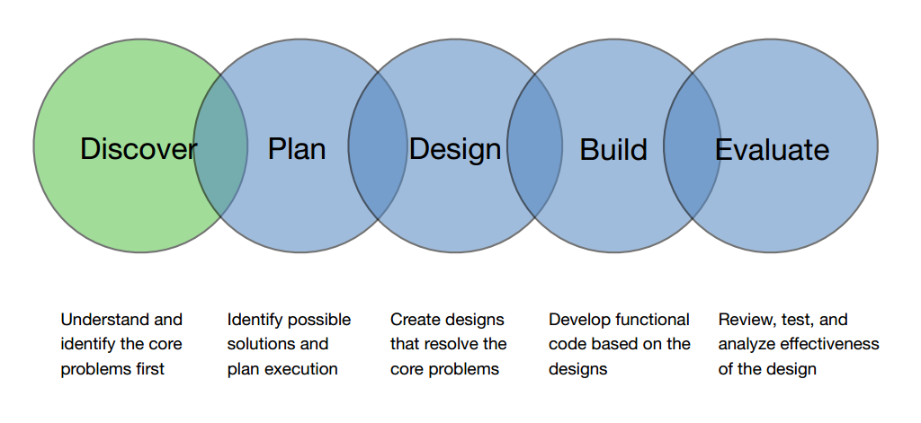
Mobile Information Architecture

Slide 7
Prototype Exercise
Create a Paper prototype for a Mobile application which helps you to find out the nearest restaurant.

Slide 8
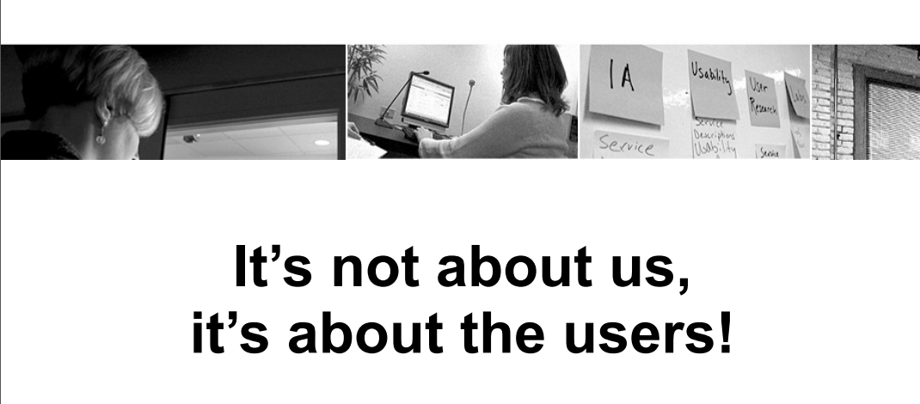

Slide 9
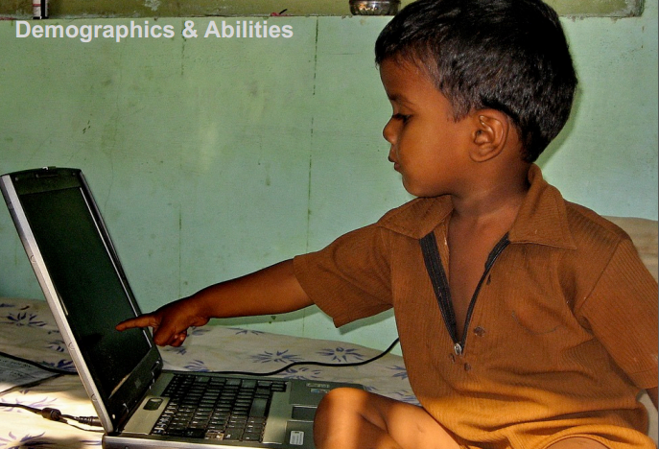
Demographic & Abilities

Slide 10

Challenges & Needs

Slide 11

Cultural & Social

Slide 12

Stakeholder Interviews

Slide 13

Kickoff Meeting

Slide 14
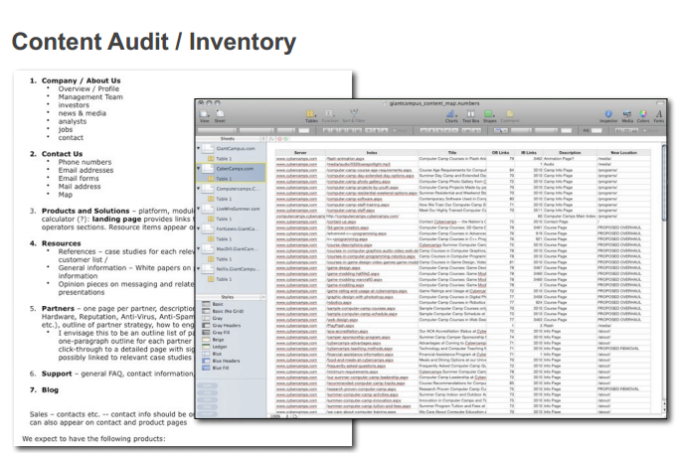
Content Audit/Inventory

Slide 15
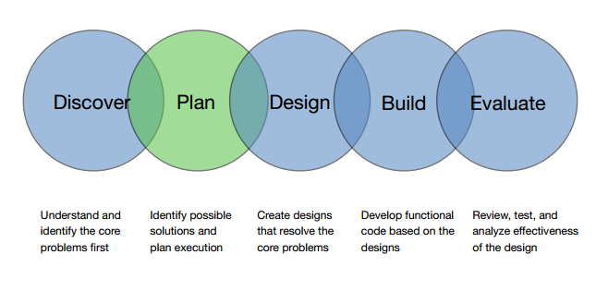

Slide 16
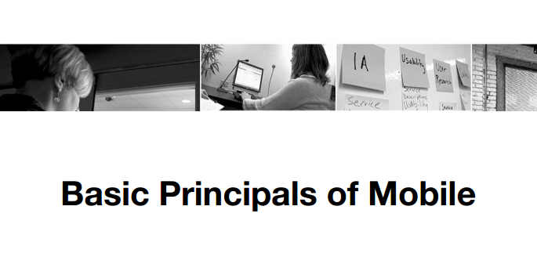

Slide 17
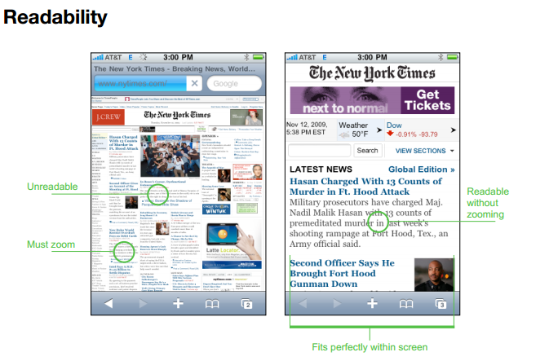

Slide 18
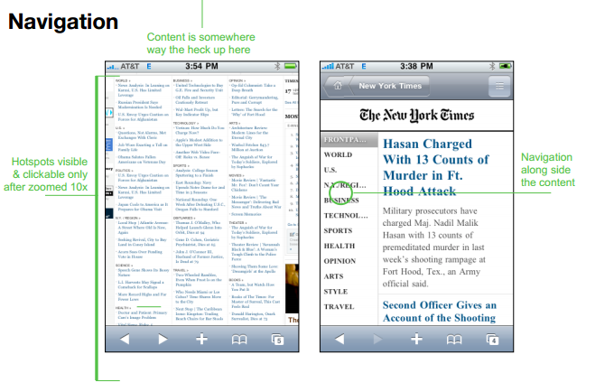

Slide 19
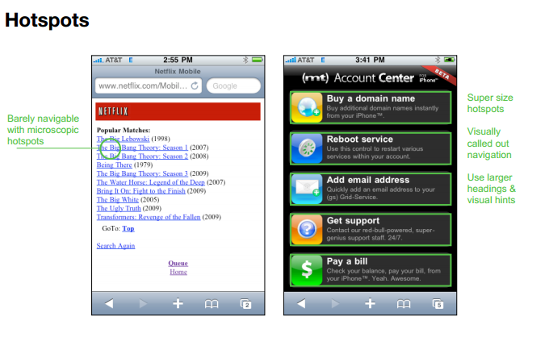

Slide 20
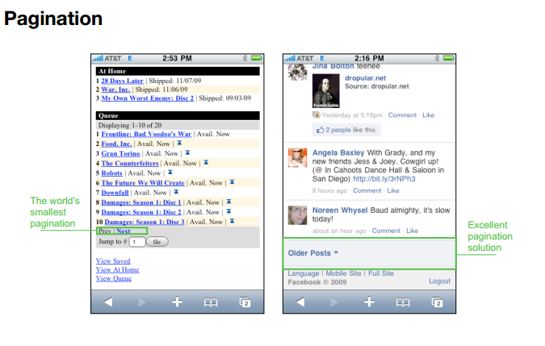

Slide 21
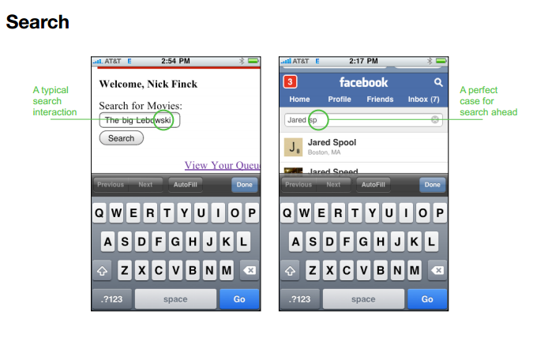

Slide 22
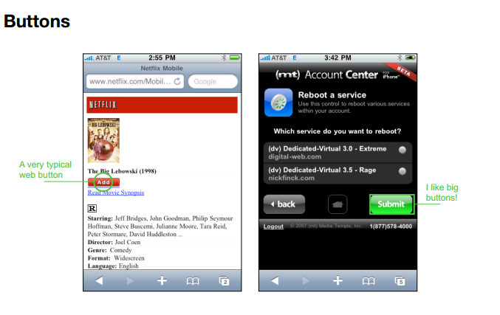

Slide 23
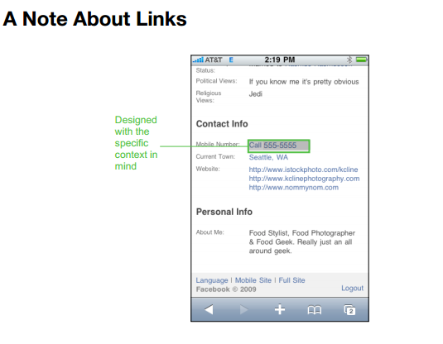

Slide 24
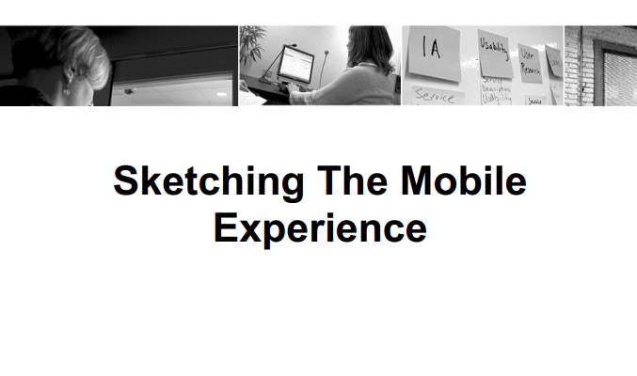

Slide 25
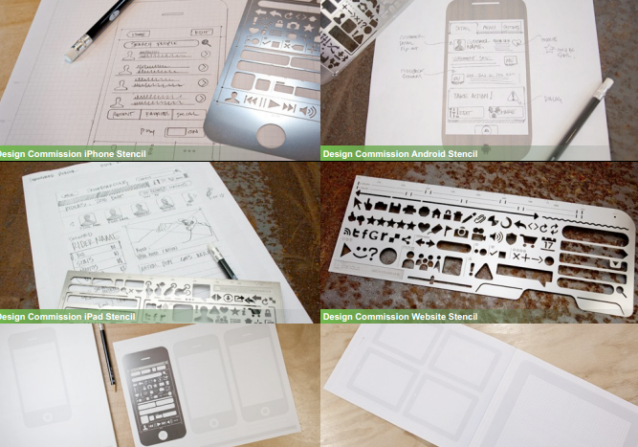

Slide 26
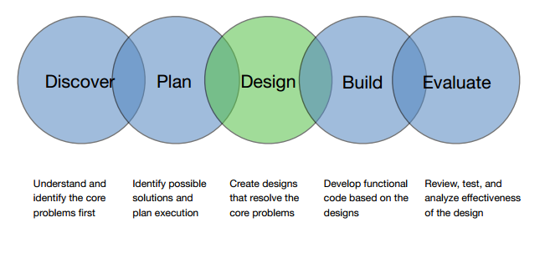

Slide 27
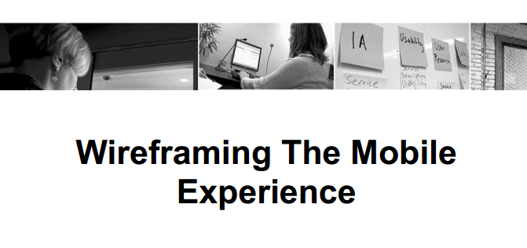

Slide 28
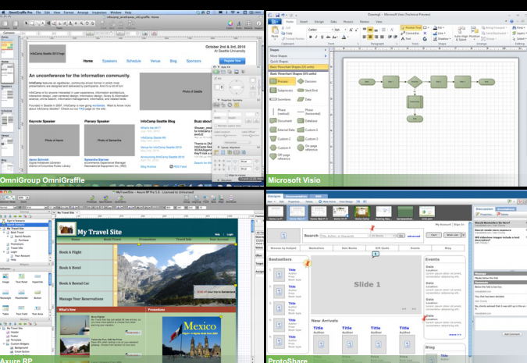

Slide 29
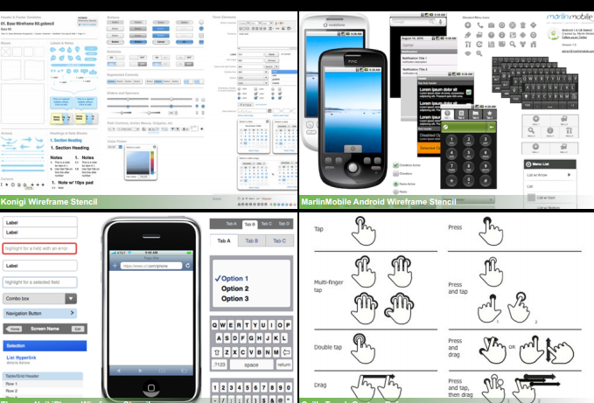

Slide 30
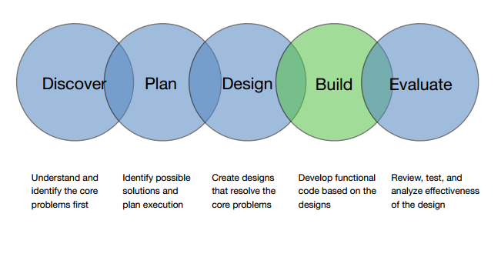

Slide 31
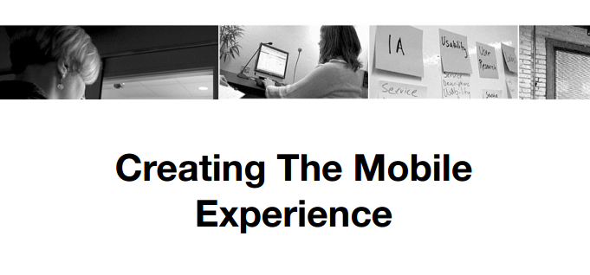

Slide 32
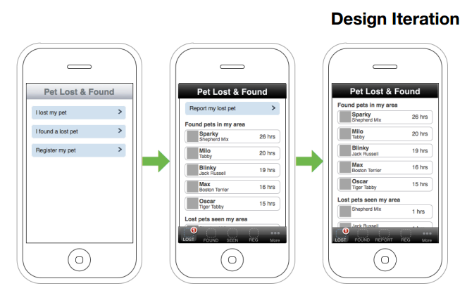

Slide 33
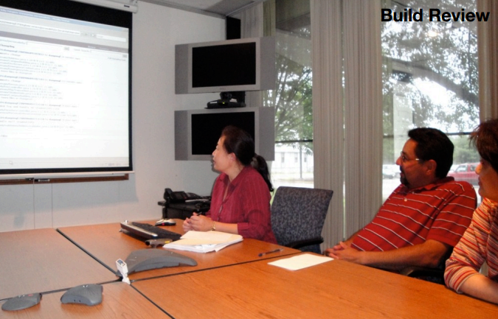
Build Review

Slide 34
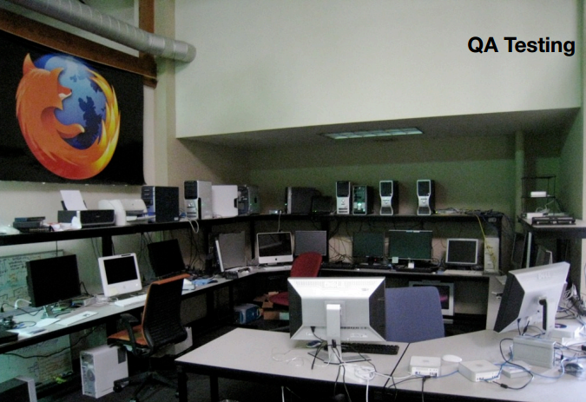
QA Testing

Slide 35
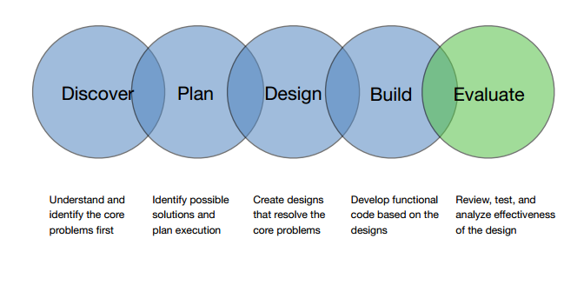

Slide 36


Slide 37
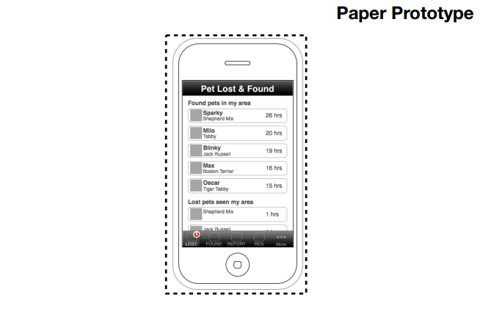

Slide 38
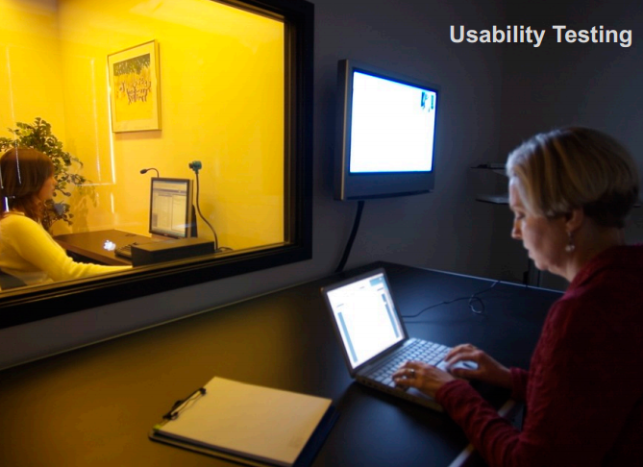
Usability Testing

Slide 39

User Interviews

Slide 40
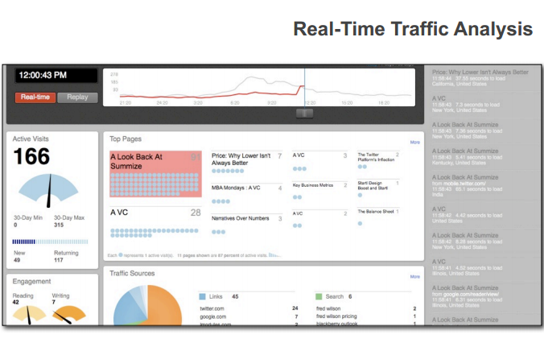

Slide 41
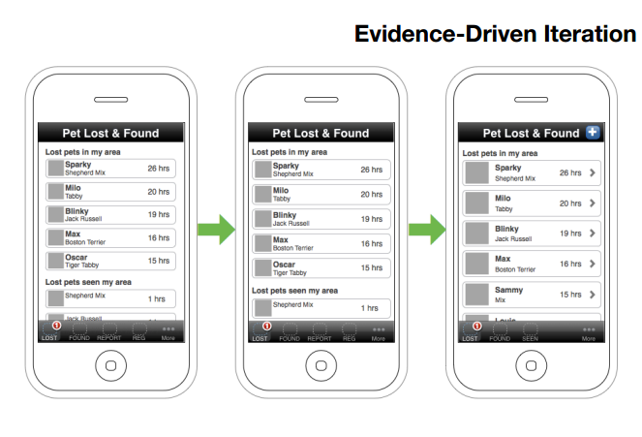

Slide 42
Mobile Apps & Strategy For the Enterprise
Best Practices
Identify a mobile Champion
Launching a mobile project requires a strong champion within the organization—ideally a C-level individual.
Keep to a limited number of stakeholders Where possible, treat the app as a “skunkworks” project. Flying under the radar will result in more rapid development and a simpler product. Conversely, excessive stakeholders may produce a “Franken-app”, which attempts to solve too many problems at once, and handles none of them well.

Slide 43
Mobile Apps & Strategy For the Enterprise
Start small and define a “minimum viable product” A majority of mobile projects simply fail to launch at all. Your top priority should be to ship Version 1.0, and get it into the hands of its actual users as soon as possible. This often results in behavior or use cases that could not have been predicted in advance. Once the product is live, iterate rapidly based on what you learn from these early users.

Slide 44
Mobile Apps & Strategy For the Enterprise
Begin with a single pain point that can be solved using mobile Unlike conventional software, a mobile app should focus strongly on one or two key goals. Identify the “micromoments”—brief, task-focused interactions —that will define the user experience, and design the app around those. When in doubt, remove features. A good app should immediately answer the question, “What is this app for?”

Slide 45
Mobile Apps & Strategy For the Enterprise
Think about how your employees or customers can use the data you already have in the cloud Many companies have significant data locked away in silos, or accessible only through complex web reporting. Use mobile to liberate this information and increase its value. For example, mobile dashboards are a good method for surfacing and summarizing actionable data, and making it instantly available from anywhere.

Slide 46
Mobile Apps & Strategy For the Enterprise
Mobile apps can run on your existing back end Apps connect to your servers through the same channels as your existing websites. You can often reuse some or all of your current online infrastructure. In addition, platforms such as force.com provide mobile back-end as a service (MBaaS). Some mobile apps may require additional server middleware to deliver current data in new forms. This issue should be considered during the app discovery and design process.

Slide 47
Mobile Apps & Strategy For the Enterprise
Don’t try to cover every device and platform from the beginning Resist the temptation to support all users immediately. As a rule, Android is more difficult to develop products for, due to the large number of potential device targets and the variety of software versions in the field. QA costs are higher, and good Android teams are more difficult to find. Therefore, it is generally easiest to begin with the iPhone, and to defer Android and tablet support until the product is well-defined.

Slide 48
Mobile Apps & Strategy For the Enterprise
Enterprise mobile users now demand a “consumer app experience” The game has changed. Employees and customers use enterprise apps on their own mobile devices, and the apps are distributed through the same channels as consumer apps. This has led to rapidly rising expectations for user experience: highly interactive interfaces, graphical data representation, and beautiful design.

Slide 49
Mobile Apps & Strategy For the Enterprise
A well-run mobile project can deliver a win within six months Mobile product cycles are short, which can produce rapid success for new initiatives. A typical six-month project arc will consist of 20% design, 50% development, and 30% QA and field testing.

Slide 50
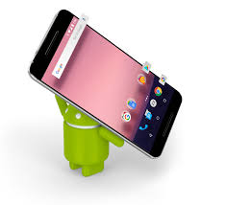
What is Android
An open source platform for mobile, embedded and wearable devices
Google is the principle contributor
HW device manufacturer can customize Android to suite their needs
Android is build on top of Linux Kernel
Android is not equivalent to Linux Kernel
Android is an open source
Android devices sales largest worldwide

Slide 51
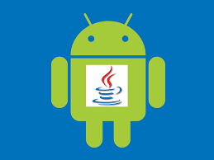
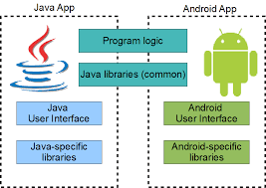
Android and Java
Android does not use the standard JVM
Android has its own JVM (Dalvik)
Android Dalvik vs standard JVM
register-based vs stack-based
more efficient and compact implementation
different set of java libraries than standard java libraries

Slide 52
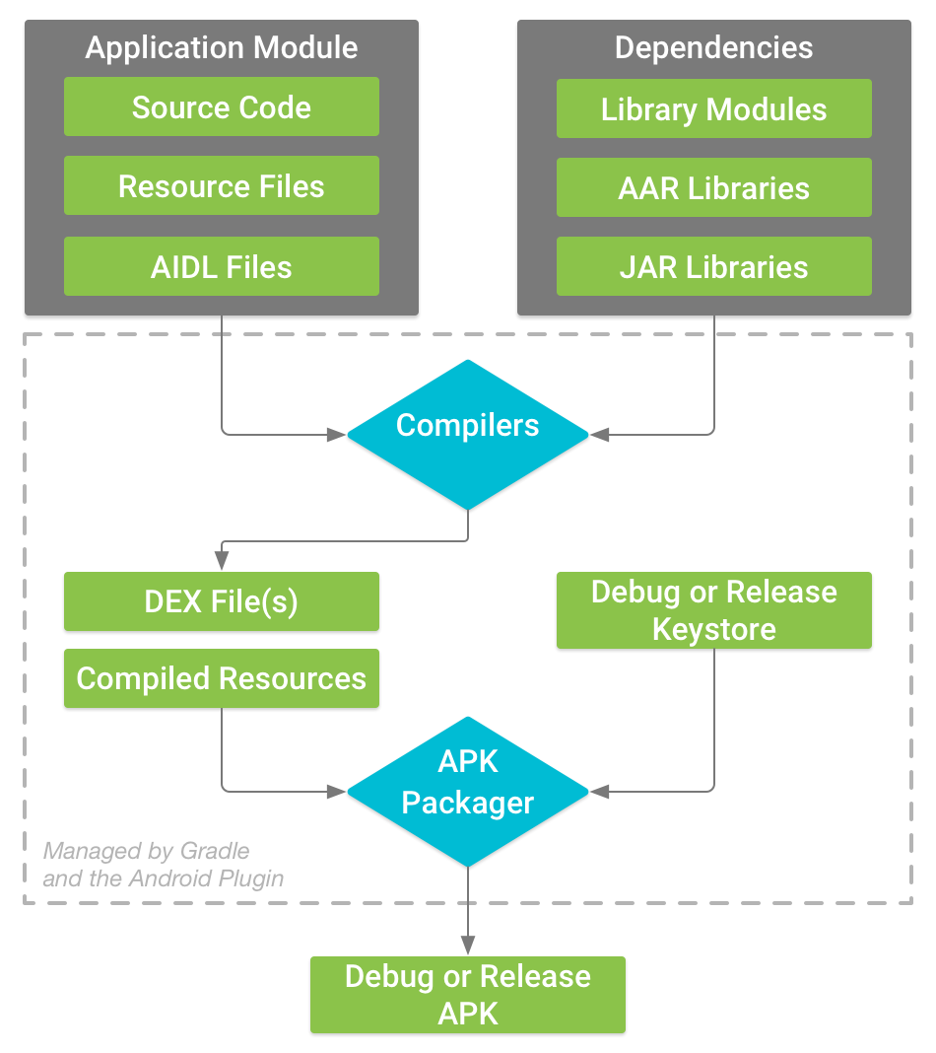
Android and Java
cannot run standard Java bytecode on Android.
provides a tool "dx" which allows to convert Java Class files into "dex" (Dalvik Executable) files.
Android applications are packed into an .apk (Android Package) file by the APK Packager
signs your APK using either the debug or release keystore.
This is all done for you with the main Android Studio IDE
Debug version (app intend only for testing) →, signs with the Defualt debug keystore auto created by Android Studio
Release version → signs your app with the release keystore. To create a release keystore, read about SIGNING APP IN ANDROID STUDIO

Slide 53
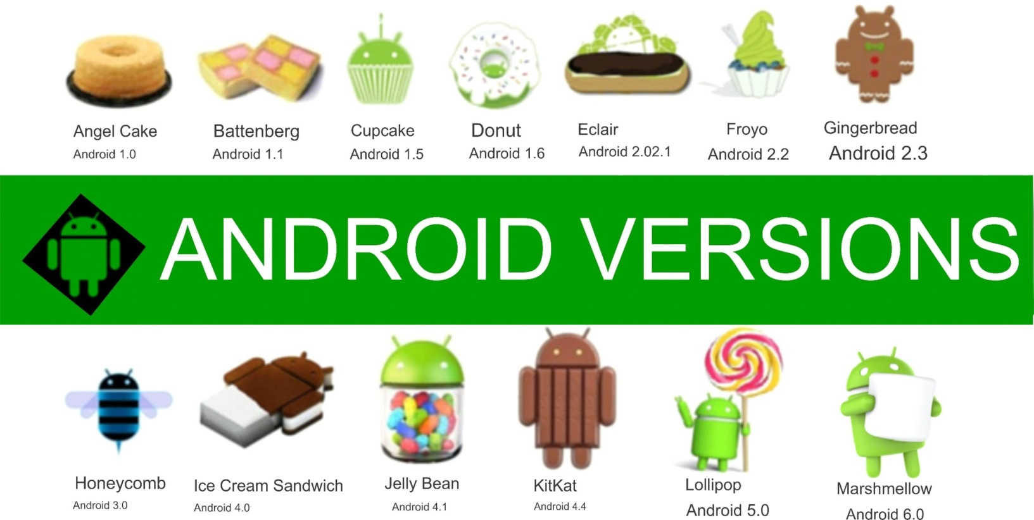
Android Versions
API evolves over time
Devices typically after some time are Out of Date –do not allow updates to new Android version –force buying of new hardware (like Apple)

Slide 54


Android Application can use 3rd party resources…
Android applications
google maps
facebook
twitter
...MORE

Slide 55
Android Application Package
Android applications are written in Java.
An Android application is bundled by the aapt tool into an Android package (.apk)
.apk
res/layout: declaration layout files
res/drawable: intended for drawing
res/admin: bitmaps, animations for transitions
res/values: externalized values
strings, colors, styles, etc
res/xml: general XML files used at runtime
res/raw: binary files (e.g. sound)
Java Code
Data Files
Resources
Files

Slide 56
Application Components
Android applications do not have a single entry point (e.g. no main() function).
They have essential components that the system can instantiate and run as needed.
Four basic components
Components | Description
Activity | UI component typically corresponding to one screen
Service | Background process without UI
Broadcast Receiver | Component that responds to broadcast Intents
Content Provider | Component that enables applications to share data

Slide 57
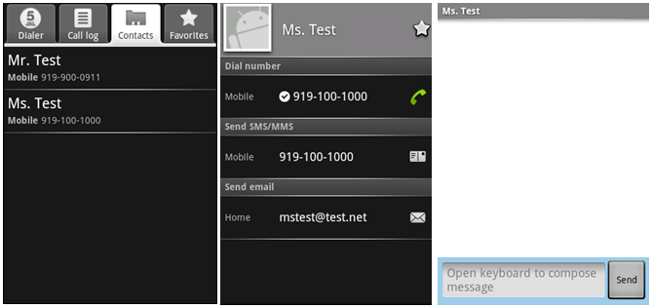
Components - Activity
An activity is usually a single screen:
Implemented as a single class extending Activity.
Displays user interface controls (views).
Reacts on user input/events.
An application typically consists of several screens:
Each screen is implemented by one activity.
Moving to the next screen means starting a new activity.
An activity may return a result to the previous activity.

Slide 58
Components - Activity (Cont)
Typically, one of the activities is marked as the first one that should be presented to the user when the application is launched.
Created “Activity” must be defined into the application’s manifest.

Slide 59
Components - Service
A service does not have a visual user interface, but rather runs in the background for an indefinite period time.
Example: music player, network download, etc
Each service extends the Service base class.
It is possible to bind to a running service and start the service if it's not already running.
While connected, it is possible communicate with the service through an interface defined in an AIDL (Android Interface Definition Language).
Notification
Service
Communication
Pause/rewind
/stop/restart
Background running
for playback
Media Player
Activity
Binder

Slide 60
Components - Service (Cont)
Adding a "Service" with Android is quite similar than for an "Activity".

Slide 61

Components - Broadcast Receivers
A broadcast receiver is a component that receives and reacts to broadcast announcements (Intents).
Many broadcasts originate in system code.
E.g. announcements that the time zone has changed, that the battery is low, etc.
Broadcast Receiver
Activity
Get incoming calls
Get incoming SMS
SMS

Slide 62
Components - Broadcast Receivers (Cont)
A broadcast receiver is a component that receives and reacts to broadcast announcements. (Cont)
Applications can also initiate broadcasts.
E.g. to let other applications know that some data has been downloaded to the device and is available for them to use.
All receivers extend the BroadcastReceiver base class.

Slide 63
Components - Content Providers
Application
Activity
Activity
Application
Application
Activity
Content Resolver
Service
Content Resolver
Content Provider
Content Resolver
Data
XML
SQLite
Remote
Store
A content provider makes a specific set of the application's data available to other applications.
The data can be stored in the file system, in an SQLite, or in any other manner that makes sense.

Slide 64
Components - Content Providers (Cont)
Using a content provider is the only way to share data between Android applications.
It extends the ContentProvider base class and implements a standard set of methods to allow access to a data store.
Querying
Delete, update, and insert data
Applications do not call these methods directly.
They use a ContentResolver object and call its methods instead.
A ContentResolver can talk to any content provider.
Content is represented by URI and MIME type.

Slide 65
Android Project Components
On creating an app in Android Studio

Slide 66
Project Components
src – your source code
gen – auto-generated code (usually just R.java)
Included libraries
Resources
Drawables (like .png images)
Layouts
Values (like strings)
Manifest file

Slide 67
XML
Used to define some of the resources
Layouts (UI)
Strings
Manifest file
Shouldn’t usually have to edit it directly, Eclipse can do that for you
Preferred way of creating UIs
Separates the description of the layout from any actual code that controls it
Can easily take a UI from one platform to another

Slide 68
Strings
In res/values
strings.xml
Application wide available strings
Promotes good software engineering
UI components made in the UI editor should have text defined in strings.xml
Strings are just one kind of ‘Value’ there are many others

Slide 69
Manifest File (1)
Contains characteristics about your application
When more than one Activity in app, NEED to specify it in manifest file
Go to graphical view of the manifest file
Add an Activity in the bottom right
Browse for the name of the activity
Need to specify Services and other components too
Also important to define permissions and external libraries, like Google Maps API

Slide 70
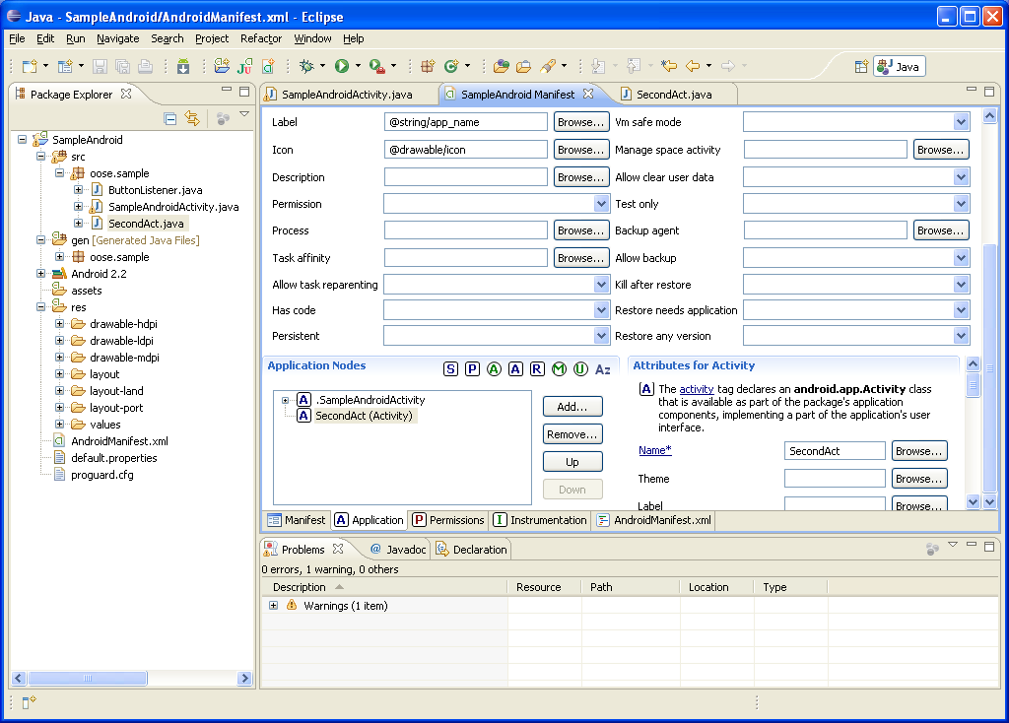
Manifest File (2) – Adding an Activity

Slide 71
R Class
Auto-generated: you shouldn’t edit it
Contains IDs of the project resources
Enforces good software engineering
Use findViewById and Resources object to get access to the resources
Ex. Button b = (Button)findViewById(R.id.button1)

Slide 72
Layouts (1)
Eclipse has a great UI creator
Generates the XML for you
Composed of View objects
Can be specified for portrait and landscape mode
Use same file name, so can make completely different UIs for the orientations without modifying any code

Slide 73
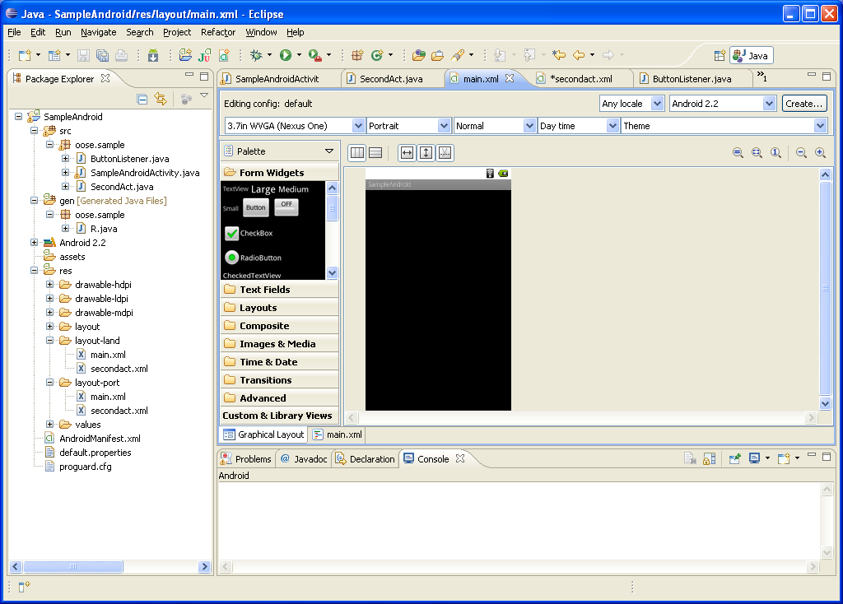
Layouts (2)

Slide 74
Layouts (3)
Click ‘Create’ to make layout modifications
When in portrait mode can select ‘Portrait’ to make a res sub folder for portrait layouts
Likewise for Landscape layouts while in landscape mode
Will create folders titled ‘layout-port’ and ‘layout-land’
Note: these ‘port’ and ‘land’ folders are examples of ‘alternate layouts’, see here for more info
http://developer.android.com/guide/topics/resources/providing-resources.html
Avoid errors by making sure components have the same id in both orientations, and that you’ve tested each orientation thoroughly

Slide 75
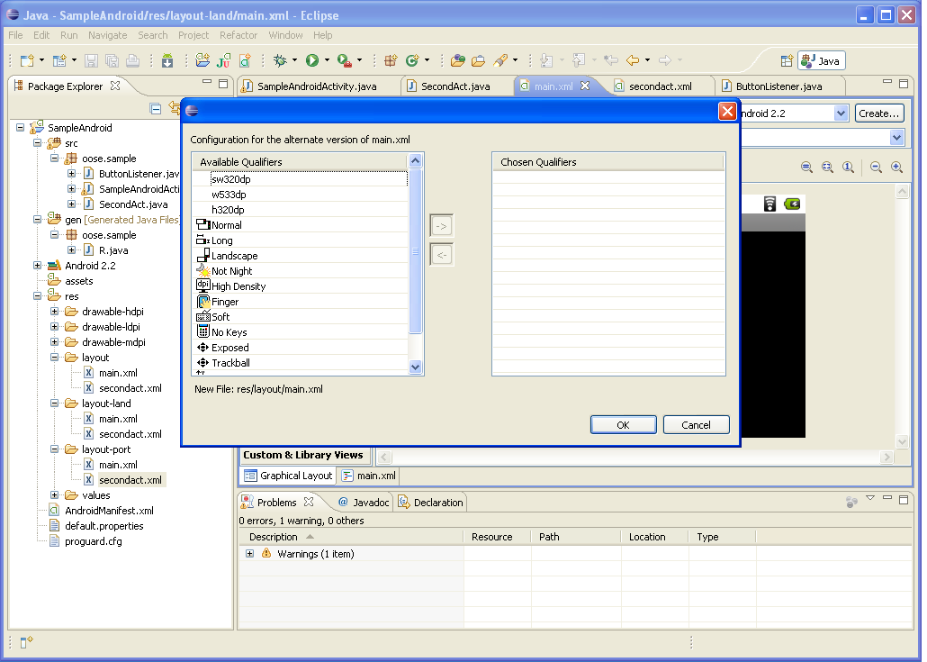
Layouts (4)

Slide 76
Component Lifecycles
Activity Lifecycle
Three states
If an activity is paused or stopped, the system can drop it from memory either by:
asking it to finish (calling its finish() method)
simply killing its process.
State | Description
Running | An activity is in the foreground of the screen (at the top of the activity stack for the current task).
Paused | An activity has lost focus but is still visible to the user.
Stopped | An activity is completely obscured by another activity. It still retains all state and member information.

Slide 77
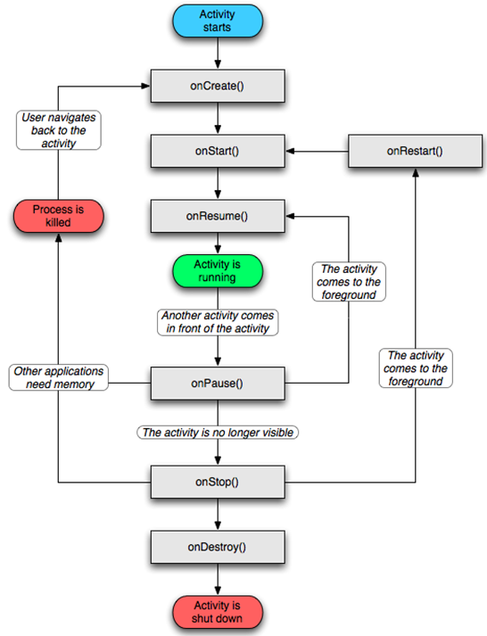

Slide 78
Component Lifecycles
Activity Lifecycle (Cont)
An activity's overall lifecycle
onCreate()
Called when the activity is first created or when the activity was killed
onStart()
Called just before the activity becomes visible to user
onResume()
Called just before the activity starts interacting with the user
At this point, the activity is at the top of the activity stack, with user input going to it.

Slide 79
Component Lifecycles (Cont)
Activity Lifecycle (Cont)
An activity's overall lifecycle (Cont)
onRestart()
Called after the activity has been stopped, just prior to it being started again
onPause()
Called when the system is about to start resuming another activity
This method is typically used to commit unsaved changes to persistent data, stop animations and other things that may be consuming CPU, and so on.

Slide 80
Component Lifecycles (Cont)
Activity Lifecycle (Cont)
An activity's overall lifecycle (Cont)
onStop()
Called when the activity is no longer visible to the user
This may happen because it is being destroyed, or because another activity has been resumed and is covering it.
onDestroy()
Called before the activity is destroyed

Slide 81
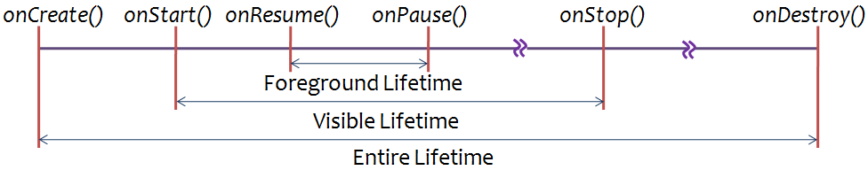
Component Lifecycles (Cont)
Activity Lifecycle (Cont)
Three nested loops for the entire lifecycle

Slide 82
Android – A First Program

Slide 83
Event Handling
So we have an interface what can we do with it.
Event Handling = code that responds when “events” happen. For GUI elements we usually have events associated with them. For example, a button has the event of hitting the button.

Slide 84
Widget : Views that have events
For a list of the widgets provided by Android, see the android.widget package.
Some Examples
Button
CheckBox
DatePicker
EditText
ImageView
SearchView
Spinner
There are more ---here are a few.

Slide 85
Event Handling
3 steps:
Decide what events to respond to
Create a listener to respond to each event
Register the listener to the corresponding widget

Slide 86
Event Handling
3 steps:
Decide what events to respond to
Create a listener to respond to each event
Register the listener to the corresponding widget
Decide what Widgets who’s events to process
Define an event listener and register it with the View.
View.OnClickListener (for handling "clicks" on a View),

Slide 87
Lets add a Button to a program-based interface
Step 1: Add button
Step 2: Register Event Handler
TWO OPTIONS – separate class to handle event(s), OR have the Activity containing the button do the event handling
Step 3: Implement Event Handler…for a Button means implementing the View.OnClickListener interface

Slide 88
Event Handling - here have a SEPARATE class
EVENT HANDLING CODE in separate object mListner
// Create an anonymous implementation of OnClickListener private OnClickListener mListener = new OnClickListener() { public void onClick(View v) { // do something when the button is clicked } }; //Now inside your Activity class protected void onCreate(Bundle savedValues) { ... // STEP 1: Capture our button from layout Button button = (Button)findViewById(R.id.button1); // STEP 2: Register the onClick listener with the implementation above button.setOnClickListener(mListener); ... }
Better for readability and reuse

Slide 89
Run your code
Depends on IDE

Slide 90
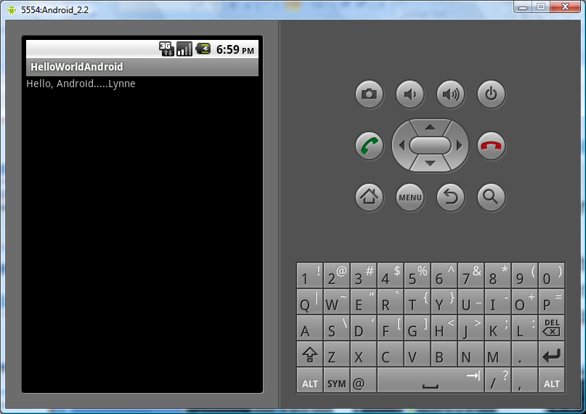
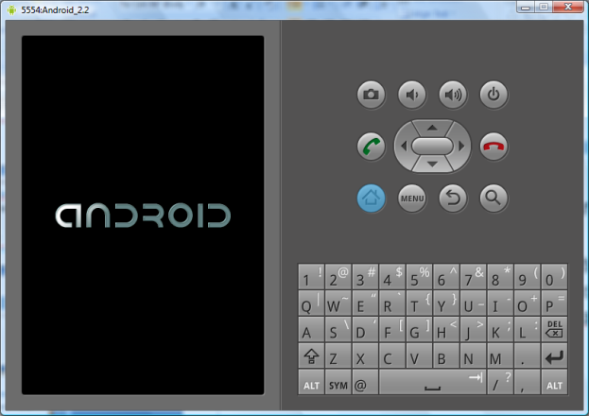
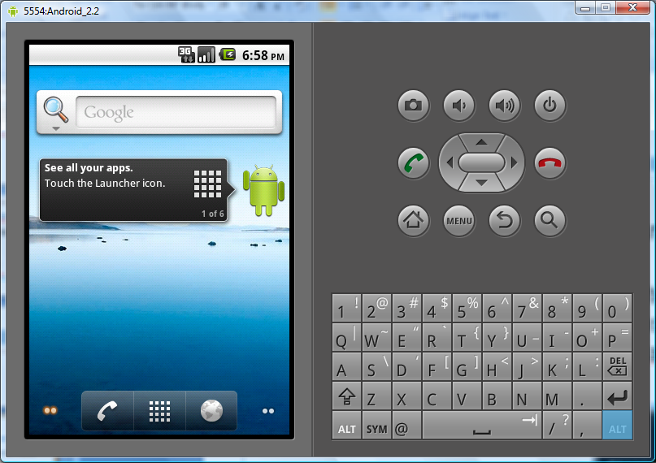
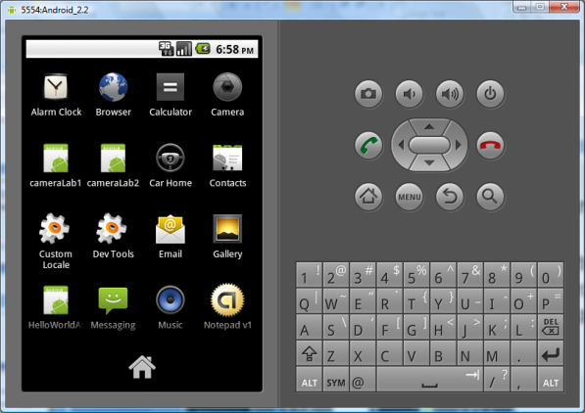
Running code
Will Run in the Emulator
Android Studio: Run->”Run app” or “Debug App”
You should learn to run both on the emulator AND on a physical device. TO use features of a phone like GPS, etc. it is often required to run on a phone

Slide 91
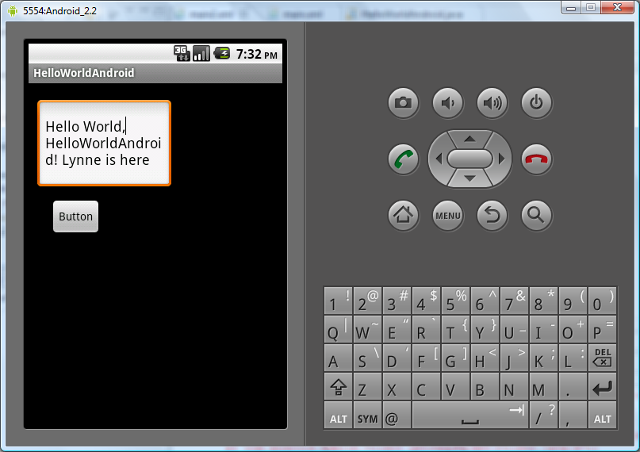
Running code
TIP: Emulator can take a long time to load at first----be patient and keep it up---just re-run after changes and won’t have to relaunch emulator, will just load up new app.
Look if you have Intell Virtualization speed up, check out GPU and snapshot options –search online for current info on these tips

Slide 92

APP FUNDAMENTALS

Slide 93
FRAGMENTS

Slide 94
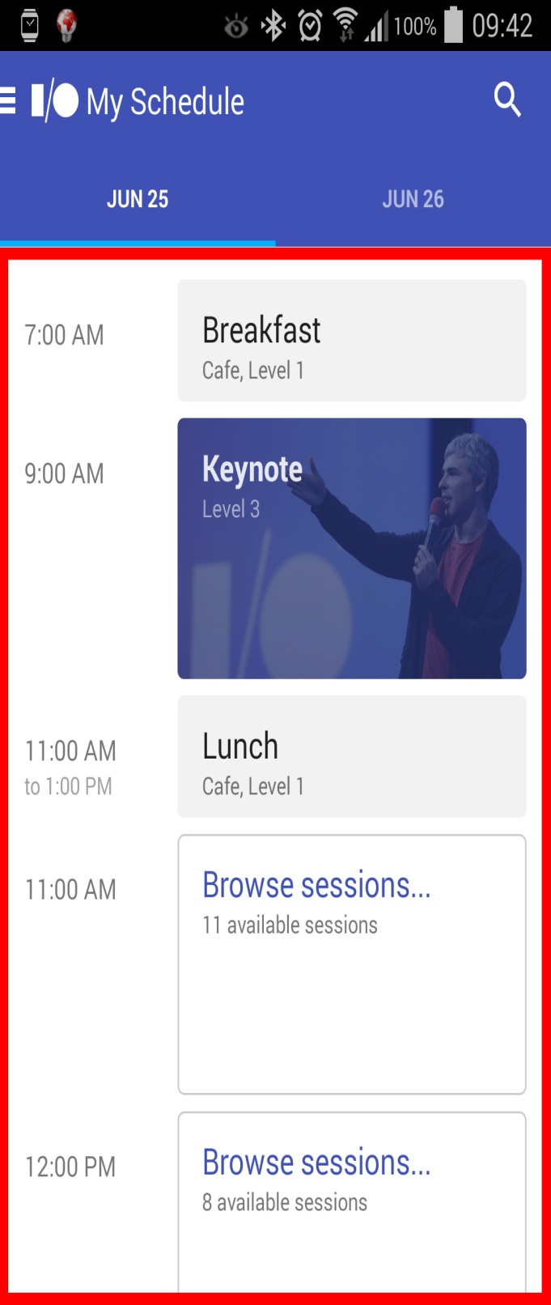
A piece of user interface that is meant to be reused
Adds modularity to your app and makes dynamic UI design easy
It has its own layout, behavior and lifecycle callbacks, but it killed/stop if the activity is too
getFragmentManager().beginTransaction().add(android.R.id.content, new MyFragment()).commit();

Slide 95
INTENTS

Slide 96
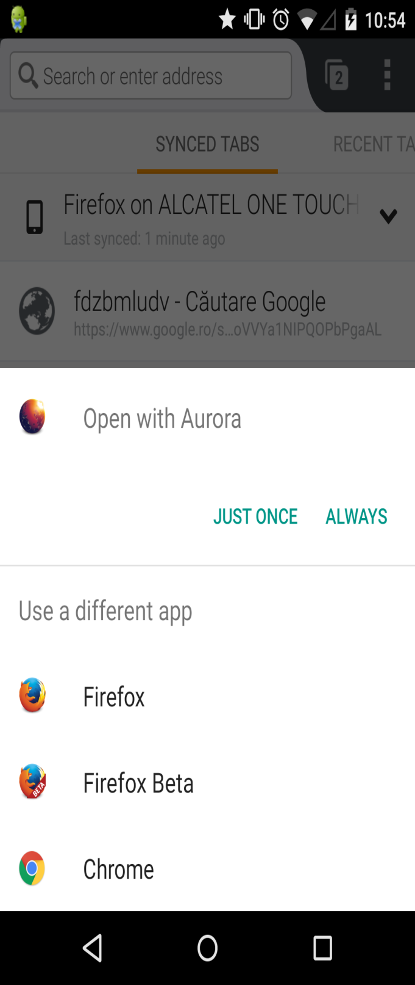
An intent is an abstract description of an operation to be performed. Think of it as an “intention” to do something
Intents can be used to start activities, services or send a broadcast
Intents are of two types – Explicit (when you know what exactly you want to do), and Implicit (when you’re not sure what you want to do)
Intent viewAmazon = new Intent(android.content.Intent.ACTION_VIEW, Uri.parse(“http://www.amazon.com”));
startActivity(viewAmazon);

Slide 97
DEVICE COMPATIBILITY

Slide 98
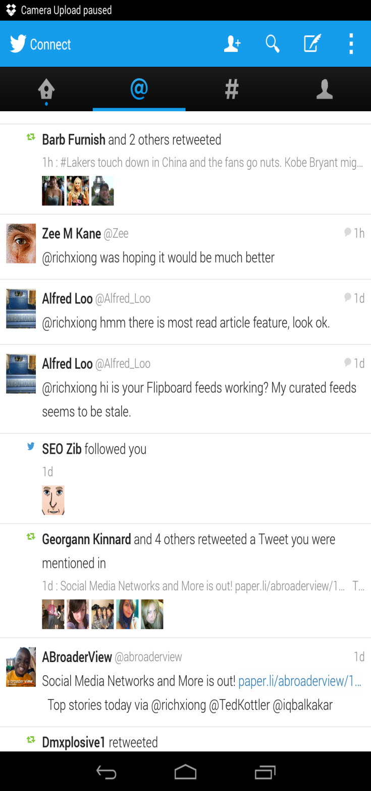
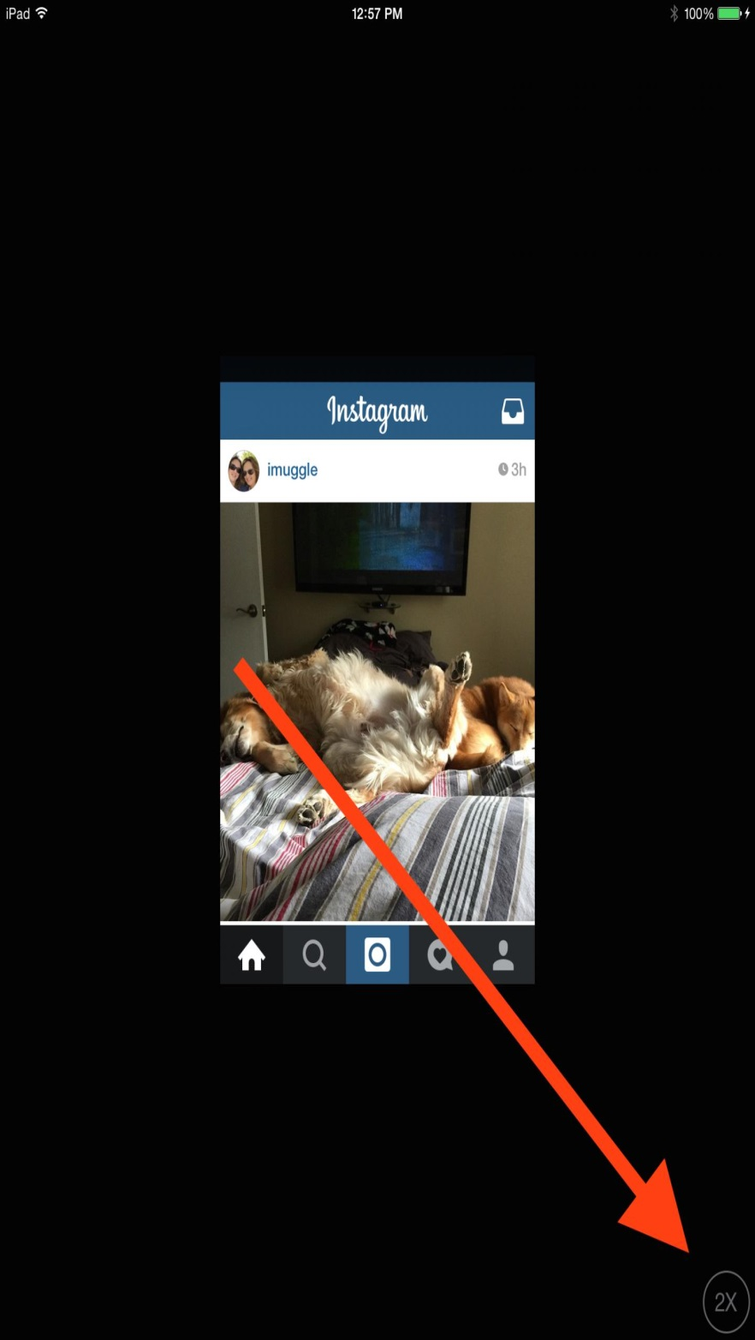

Slide 99
DISTRIBUTION

Slide 100


Slide 101
ADB

Slide 102
ADB – Android Debug Bridge
Connect to an Android device or emulator
Read logcat
Install, reinstall or uninstall apps
Send/retrieve files to/from device storage
Forward ports
Record screen or take screenshots
Reboot your phone into boot loader or recovery mode
Take backups or restore them
Execute shell commands

Slide 103
Device monitor

Slide 104


Slide 105
LOGCAT

Slide 106


Slide 107
SDK MANAGER

Slide 108


Slide 109
WORKFLOW

Slide 110


